Slide 1
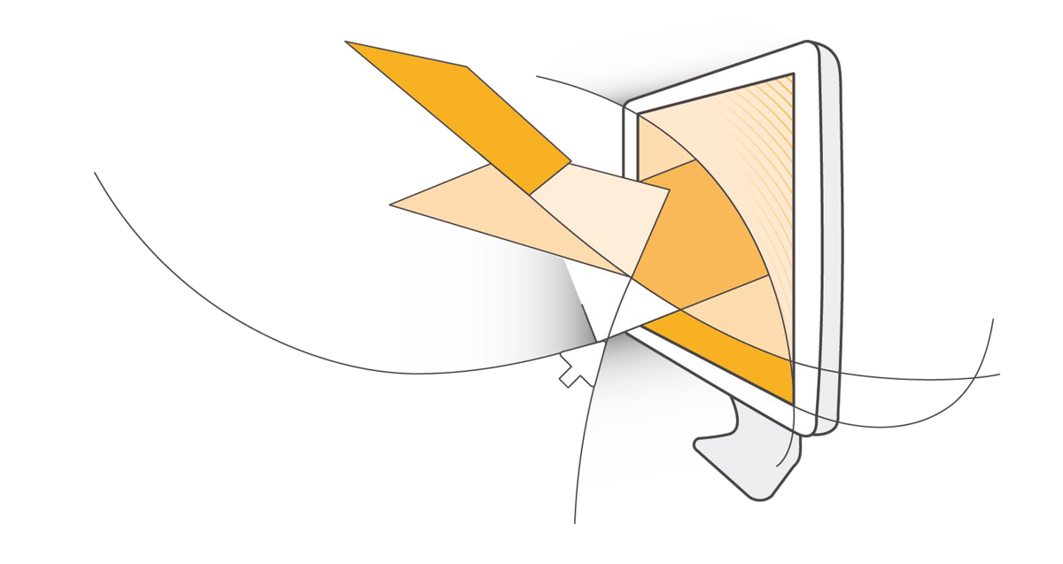
Amazon Web Services
For Government, Education, and Nonprofit Organizations
2017

Slide 2
AWS Agenda
What is cloud computing?
What is AWS (EC2 and S3)?
What is Big Data?
What is EMR?
What is Redshift?

Slide 3

Presenters
Mv – Marcus Vinicius Ferreira
mvferr@amazon.com
Solutions Architect, AWS Public Sector
Technical Trainer
Previous: Oracle, Sun, Abril, Baby, Dinda, Nubank
Notes:
Update this slide with presenters

Slide 4
Presenters
Claudia Charro
ccharro@amazon.com
Solutions Architect
Technical Trainer
Notes:
Update this slide with presenters

Slide 5


What Is (True) Cloud Computing?
The on-demand delivery of IT resources over public or private networks with zero up-front costs, no long-term contracts, and pay-as-you-go pricing

Slide 6


Amazon.com…
?
… AWS: the leader in utility (aka cloud) computing

Slide 7
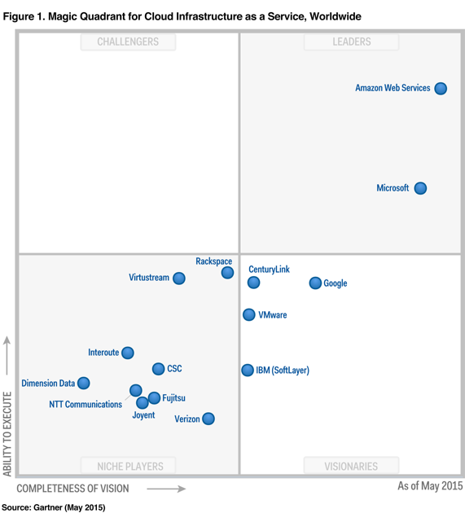
AWS is Leader and Visionary
Gartner Magic Quadrant for Cloud Infrastructure as a Service, Worldwide
Source: Gartner (May 2015)
Gartner “Magic Quadrant for Cloud Infrastructure as a Service, Worldwide,” Lydia Leong, Douglas Toombs, Bob Gill, May 18, 2015. This Magic Quadrant graphic was published by Gartner, Inc. as part of a larger research note and should be evaluated in the context of the entire report. The Gartner report is available at http://aws.amazon.com/resources/analyst-reports/. Gartner does not endorse any vendor, product or service depicted in its research publications, and does not advise technology users to select only those vendors with the highest ratings or other designation. Gartner research publications consist of the opinions of Gartner's research organization and should not be construed as statements of fact. Gartner disclaims all warranties, expressed or implied, with respect to this research, including any warranties of merchantability or fitness for a particular purpose.
7

Slide 8




AWS in the Public Sector
2,000+
5,000+
17,500+
government agencies
educational institutions
nonprofit organizations
8

Slide 9





















AWS is Architected for Government Security Requirements
Certifications and accreditations for workloads that matter – Compliant Solutions
AWS CloudTrail and AWS Config – Call logging and configuration management for governance and compliance
MTCS
Log, review, alarm on all user actions
Browse-and-query database of current and previous state of cloud resources
https://aws.amazon.com/compliance/
9

Slide 10
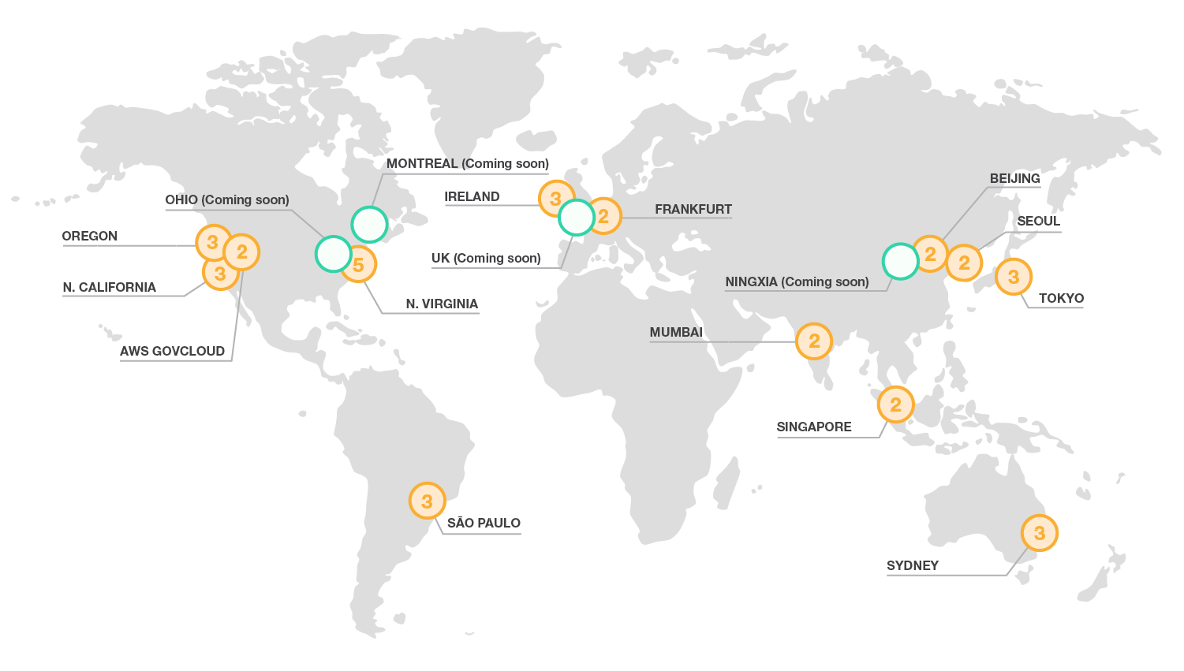
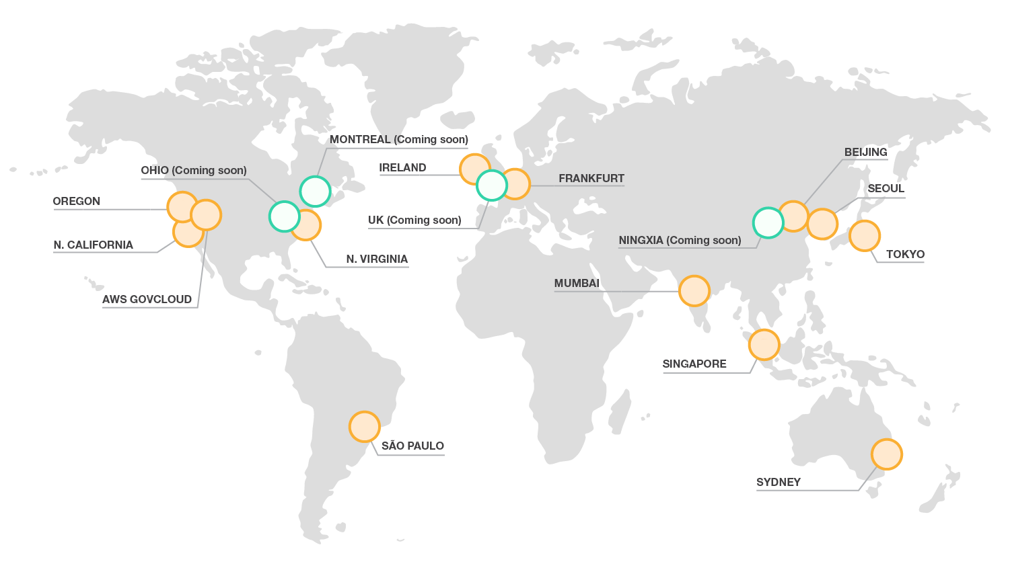
The Global Infrastructure
#
Region &
Number of Availability Zones
Region
New Region
Coming Soon
Edge Location
Notes:
We briefly mentioned Regions before… Regions are the orange circles and think of them as geographically seperated parts of the world. And a Region is divided into what we call Availability Zones. But as you can see we have 13 Regions (with 4 more coming on line soon) around with world spread out over 5 continents.
But think of a Region as a way to run your application in a geographical location that’s closest to your users... Or maybe you have to comply with regulatory requirements which says you need to store data within a country of origin. So each Region is independent for data sovereignty purposes.
You can see there’s also a GovCloud Region.. AWS GovCloud (US) is an isolated AWS Region designed to allow US government agencies and customers to move workloads into the cloud by helping them meet certain regulatory and compliance requirements. The AWS GovCloud (US) framework allows US government agencies and their contractors to comply with U.S. International Traffic in Arms Regulations (ITAR) regulations as well as the Federal Risk and Authorization Management Program (FedRAMP) requirements. AWS GovCloud (US) has received an Agency Authorization to Operate (ATO) from the US Department of Health and Human Services (HHS) utilizing a FedRAMP accredited Third Party Assessment Organization (3PAO) for several AWS services.
<click>
Talk about our global network of Edge Locations
<click>
But we do Regions a little differently than other’s in the industry. We further break a Region into Availability Zones. You can see that a Region always contains 2 or more Availability Zones…
Let’s take a look at a Region in more detail... <click> in this case, let’s look at the Oregon Region which has 3 AZs
<click to create a seamless conversation as we dive further into a Region>

Slide 11
~ 2ms latency
3
REGION
DC
DC
AZb
AZa
DC
DC
DC
DC
AZc
DC
DC
DC
TC
TC
Redundant Tier-1 Internet & Inter-Region Connectivity
Notes:
Each availability zone is designed as an independent failure zone. This means that availability zones are physically separated within a typical metropolitan region and are located in lower risk flood plains (specific flood zone categorization varies by Region). In addition to discrete uninterruptable power supply (UPS) and onsite backup generation facilities, they are each fed via different grids from independent utilities to further reduce single points of failure. Availability zones are all redundantly connected to multiple tier-1 transit providers.
And each AZ contains multiple physical datacenters linked together
Each Availability Zone is connected to other AZs in the Region with high-speed network connectivity.
And within a Region, the AZs are connected to Transient Centers which have redundant tier 1 internet connectivity and dedicated Region-to-Region connectivity
TIP: James Hamilton does an excellent job of describing AWS’s Regions and Availability Zones in this presentation: https://www.youtube.com/watch?v=JIQETrFC_SQ

Slide 12
AWS Regions and Availability Zones (AZ)
US Regions
Global Regions
US East (VA)
GovCloud (US)
Asia Pacific (Tokyo)
Asia Pacific (Singapore)
Asia Pacific (Sydney)
China (Beijing)
AZ - A
AZ - B
AZ - A
AZ - B
AZ - A
AZ - B
AZ - A
AZ - B
AZ - A
AZ - B
AZ - A
AZ - B
AZ - C
AZ - D
AZ - C
AZ - E
US West (CA)
US West (OR)
South America (São Paulo)
EU (Ireland)
EU (Frankfurt)
AZ - A
AZ - B
AZ - A
AZ - B
AZ - A
AZ - B
AZ - A
AZ - B
AZ - A
AZ - B
AZ - C
AZ - C
AZ - C
AZ - C
Note: Conceptual drawing only. The number of Availability Zones (AZ) may vary.
Notes:
AWS products and services like Amazon Elastic Compute Cloud (Amazon EC2) are offered by region. All regions have at least two Availability Zones (AZ) for redundancy.
Availability Zones are analogous to clusters of datacenters. Where natural disasters or fault lines are a consideration, we isolate them so that they are not easily affected at the same time. There is a latency of less tan 10 milliseconds between Availability Zones. Availability Zones are physically distinct groups of data centers. A region is made of multiple availability zones so as to allow our customers the ability to spread their computing resource across multiple power providers. Where natural disasters are a serious consideration we do our best to isolate AZs from each other. For example, where earthquakes are a problem we would not build two AZs on the same fault line.
More information about AWS global infrastructure can be found online: http://aws.amazon.com/about-aws/global-infrastructure/regional-product-services/
More information about the China Region: https://www.amazonaws.cn/en/

Slide 14
What is Simple Storage Service (S3)?

Slide 15

Store anything Object storage Scalable 99.999999999% durability
Unlimited Storage as a Data Lake
Amazon S3
Notes:
Fundamental storage at internet scale, it can store any number of objects from 1 byte to 5 TB in size
It is engineered for 11 9’s of durability replicating your data at least three times in three distinct physical data centers we call availability zones
We have customers such as Dropbox, Spotify, Pinterest store billions of objects or files as photos, videos, songs, or any other type of file.

Slide 16



Amazon S3
Amazon S3
To upload your data (photos, videos, documents, etc.):
Create a bucket in one of the AWS Regions.
Upload any number of objects to the bucket.
Bucket
[bucket name]
https://s3-ap-northeast-1.amazonaws.com/[bucket name]/
Region code
Bucket name
Object
Preview2.mp4
https://s3-ap-northeast-1.amazonaws.com/[bucket name]/Preview2.mp4
Tokyo Region (ap-northeast-1)
Key
Notes:
To get the most out of Amazon S3, you need to understand a few simple concepts. First, Amazon S3 stores data inside of "buckets". Buckets are essentially the prefix for a set of files, and as such must be uniquely named in that region. Buckets are logical containers for objects. You can have one or more buckets in your account. For each bucket, you can control access, in other words, who can create, delete and list objects in the bucket. You can also view access logs for the bucket, and its objects, and choose the geographical region where Amazon S3 will store the bucket and its contents.
In the example here, we've used Amazon S3 to create a bucket in the Tokyo region, which is identified within AWS formally by its region code, as "ap-northeast-1").
The URL for a bucket is structured as displayed here, with the region code first, followed by amazonaws.com, followed by the bucket name.
Amazon S3 refers to files as "objects". Once you have a bucket, you can store any number of objects inside of it. An object is composed of data, and any metadata that describes that file. To store an object in Amazon S3, you upload the file you want to store into a bucket. When you upload a file, you can set permission on the data as well as any metadata.
In this example, we're storing the object "Preview2.mp4" inside of our bucket.
The URL for the file includes the object name at the end.

Slide 17
What is Elastic Cloud Compute (EC2)?

Slide 18


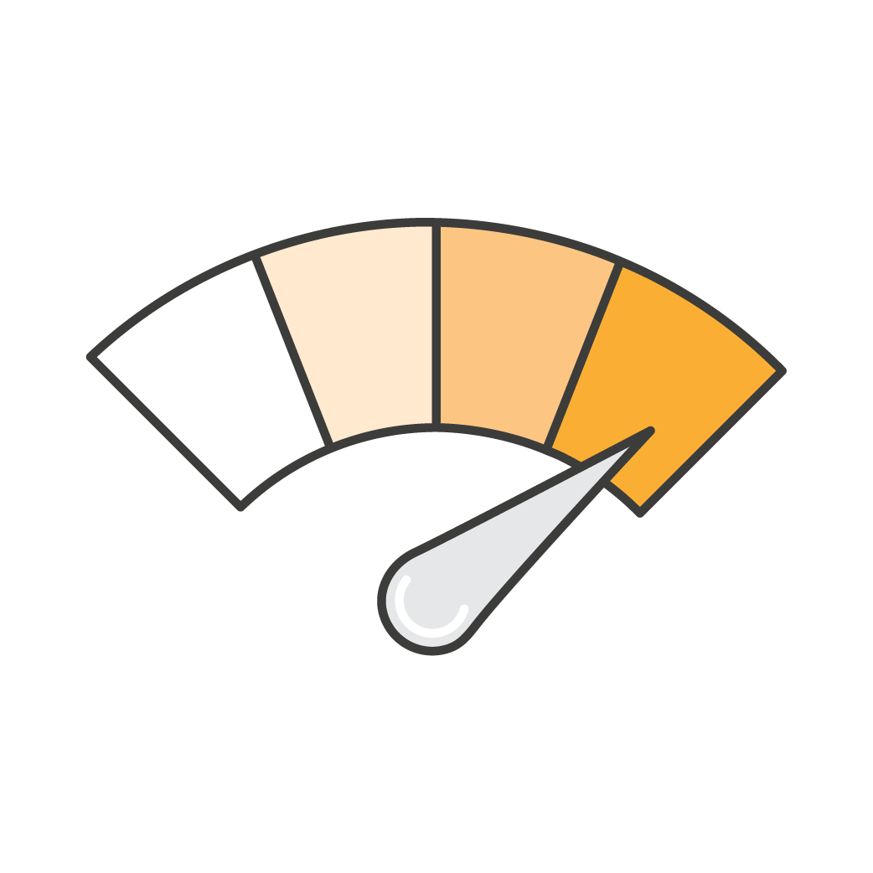

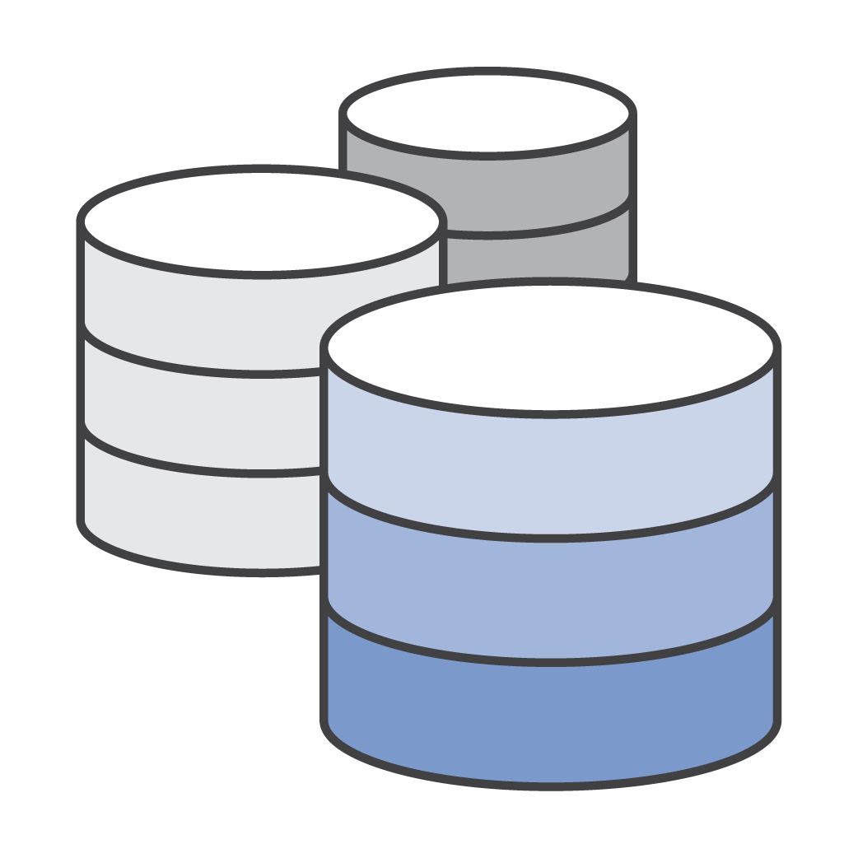


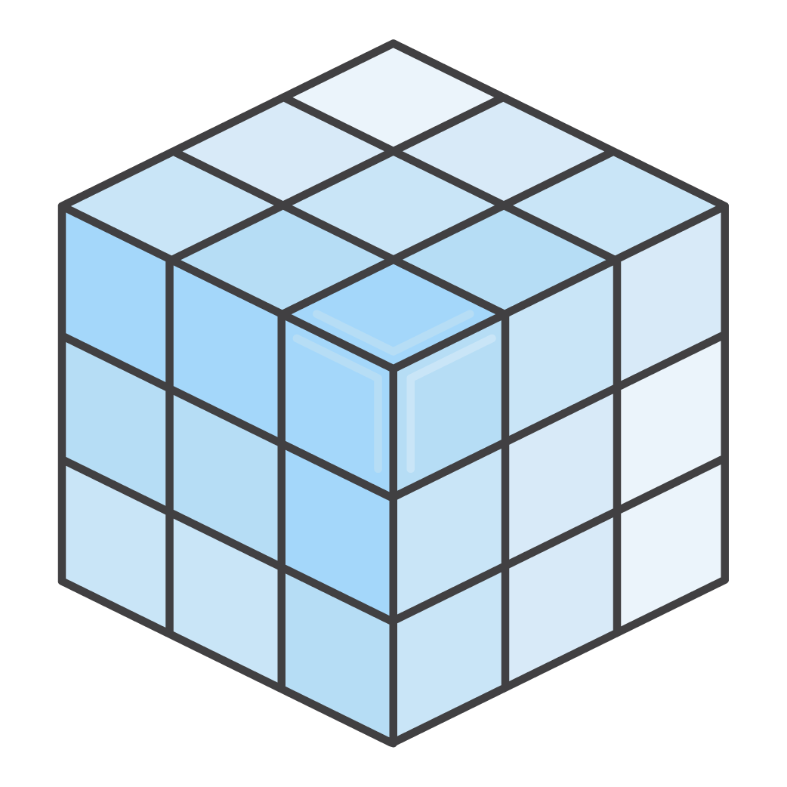
Compute: EC2 Instance Families
General
purpose
Compute
optimized
Burstable
performance
Dense-storage & High-I/O optimized
GPU
enabled
Memory
optimized
M4
C4
T2
D2
I2
G2
R3
M3
C3
Notes:
If appropriate, take the opportunity to expand upon the various AWS instance types.
http://aws.amazon.com/ec2/instance-types/
http://docs.aws.amazon.com/AWSEC2/latest/UserGuide/instance-types.html

Slide 19
Amazon EC2 Instances
256
128
64
32
16
8
4
2
1
 | 1 | 2 | 4 | 8 | 16 | 32 | 64 | 128
Cluster High Memory and High Storage
High Memory
Cluster Compute
and High I/O
Memory (GB)
General Purpose
High CPU
Micro
Amazon EC2 Compute Units
Notes:
Amazon EC2 lets you choose from a number of different instance types to meet your computing needs. Each instance provides a predictable amount of dedicated compute capacity and is charged per instance-hour consumed. First-generation (M1) general purpose instances provide a balanced set of resources and a low-cost platform that is well suited for a wide variety of applications. Second-generation (M3) general purpose instances provide a balanced set of resources and a higher level of processing performance compared to First-generation general purpose instances. Instances in this family are ideal for applications that require higher absolute CPU and memory performance. Applications that can benefit from the performance of second-generation general purpose instances include encoding applications, high traffic content management systems, and Memcached applications. High-memory instances offer large memory sizes for high throughput applications, including database and memory caching applications. High-CPU Instances have proportionally more CPU resources than memory (RAM) and are well suited for compute-intensive applications. There are also various high-storage and cluster-computer instance types available.

Slide 20


Virtualization: Development goes to the cloud
Project A
Dev
Your Data Center

Slide 21
Virtualization: Development and RESEARCH
Engineer Python
Physical Cluster C++/Fortran
Bio Informatics Perl
Your LAN
Segments
Your Data Center
AWS VPC
… and use dedicated clusters for specific software solutions
Physics Java

Slide 22

Also: EC2 AMIs to the RESCUE!
AMI for Python
Your LAN
Segments
AMI for Perl
AWS VPC
AMI for Java
Remember: DO NOT share your clusters!

Slide 23





Cloud Storage: Backup and Analytics
Legacy data centers
AWS cloud
App 1
ANALYTICS
Amazon EMR
App 2
App 3
•
•
•
BACKUP
Amazon Redshift
App N
Amazon S3
23

Slide 24
What is Relation Database Service (RDS)?

Slide 25

Amazon Relational Database Service (RDS)
Amazon RDS is a fully managed relational database service.
Choice of database engines:
MySQL, Oracle, Microsoft SQL Server, PostgreSQL
Amazon Aurora
Simple to deploy and scale.
Reliable and cost-effective.
Notes:
Amazon Relational Database Service (Amazon RDS) is a managed service that makes it easy to set up, operate, and scale a relational database in the cloud. It provides cost-efficient and resizable capacity, while managing time-consuming database administration tasks, freeing you up to focus on your applications and business.
Amazon RDS gives you access to the capabilities of a familiar MySQL, Oracle, SQL Server, or PostgreSQL database. This means that the code, applications, and tools you already use today with your existing databases should work seamlessly with Amazon RDS. Amazon RDS automatically patches the database software and backs up your database, storing the backups for a user-defined retention period. You benefit from the flexibility of being able to scale the compute resources or storage capacity associated with your relational database instance via a single API call or few clicks of the AWS Management Console. In addition, Amazon RDS makes it easy to use replication to enhance database availability, improve data durability, or scale beyond the capacity constraints of a single database instance for read-heavy database workloads.

Slide 26
What is DynamoDB?

Slide 27

Amazon DynamoDB
Amazon DynamoDB is a NoSQL database service.
Key/Value store.
High-Throughput table access.
Unlimited table size.

Slide 28
What is Big Data?

Slide 29


Overview: Big Data
When does data become “big data”?
When data sets become so large that you have issues collecting, storing, organizing, analyzing, moving, and sharing them.
The velocity, volume, and variety of data outgrows your ability to process it.
Notes:
As data is collected, the sheer volume of it can cause issues, especially in on-premises environments. With the accumulation of more and more data, it becomes increasingly difficult to move the data to the applications that need to process it. In these circumstances, it is much simpler to move the applications to the data instead. This is very difficult to do in on-premises environments. In response, the rise of cloud providers has facilitated the ability to move applications to the data more easily.
Multiple sources of data result in large volumes, velocity, and variety:
Computer-generated data
Application server logs: websites, games
Sensor data: weather, water, smart grids
Images and videos: traffic, security cameras
Human-generated data
Blogs, reviews, emails, pictures
Social media/graph analysis
Brand perception
Computer-generated data can vary from semi-structured logs to unstructured binaries. This data source can produce pattern-matching or correlations that generate recommendations (for social networking and online gaming in particular). You can also use computer-generated data to track application or service behavior. Human-generated data includes email searches (legal fact discovery), natural language processing, sentiment analysis on products or companies, and product recommendations. Social graph analysis can produce product recommendations based on your circle of friends, jobs you may find interesting, or even reminders based on your circle of friends (birthdays, anniversaries, and so on).
Image: https://pixabay.com/en/graph-data-growth-bar-chart-chart-163549/

Slide 30
The Big Data "Pipeline"
Collect
Process & Analyze
Visualize
Data
Insight
Store

Slide 31
Visualization
Collect
Process & Analyze
Visualize
Data
Insight
Store

Slide 32
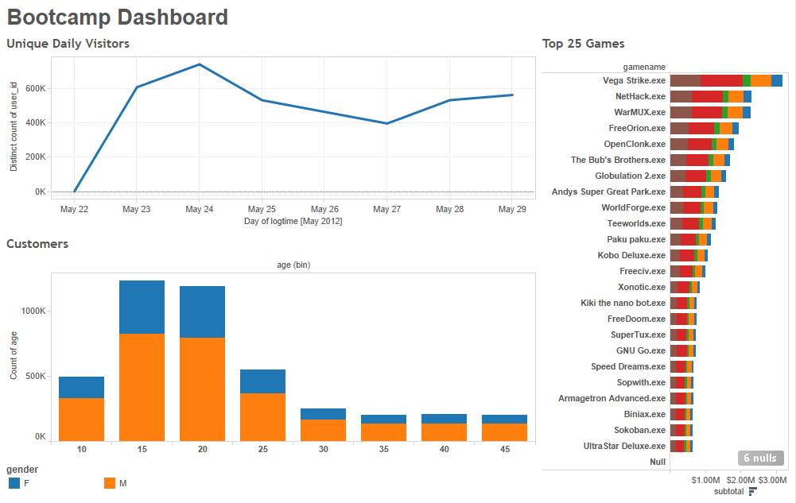
Visualization: Tableau
Explore, visualize data in minutes
Drag-and-drop interface to create visualizations, dashboards
Uses Visual Query Language on data
Data engine analyzes big data faster than traditional queries
Blend data from multiple sources for rich visualizations
Works with Amazon Redshift, Amazon RDS, Amazon EMR
Notes:
Whitepaper: Tableau Server on AWS – Deployment Guidelines and Best Practices: http://d0.awsstatic.com/whitepapers/tableau-server-on-aws.pdf

Slide 33
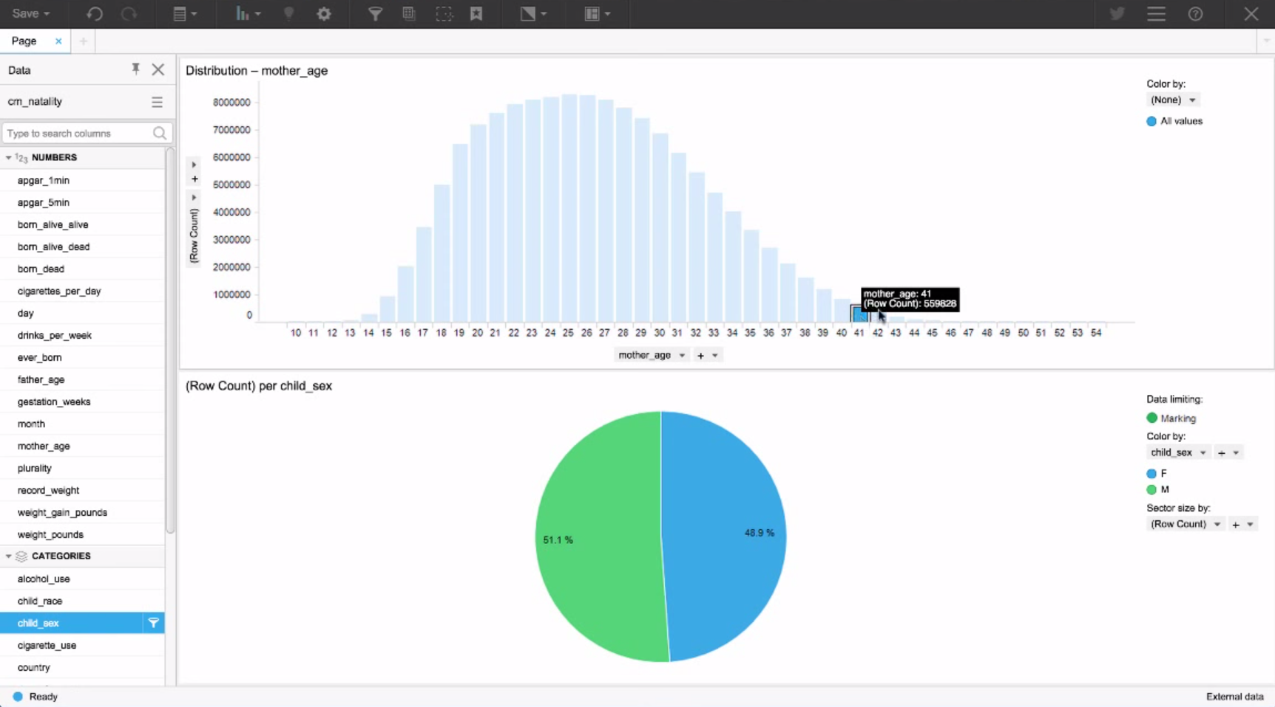
Visualization: Spotfire
Can analyze very large data sets from a large variety of sources
Creates visualization in-memory for faster response time
Offers Spotfire Recommendations
Inspects your data automatically
Makes suggestions about how to best visualize it
Works with Amazon Redshift and Amazon RDS
Provides ability to plot your data on geographic maps
Share your findings on Twitter

Slide 34
The Big Data "Pipeline”: Latency
Collect
Process & Analyze
Visualize
Data
Insight
Store
Time-to-answer (latency)
- Balance of throughput and cost
Notes:
The general flow of a big data pipeline starts with data and ends with insight. How you get from start to finish depends on a host of factors, however most big data workflows follow the following pattern:
Data is ingested (collected) by an appropriate tool.
This data then has to be stored in a persistent way.
The data then needs to be processed and/or analyzed. The data processing/analysis solution takes the data from storage, performs operations, then stores the data again. This data can then be used by other processing/analysis tools or by the same tool again to get further answers from the data.
To make answers useful to business users, they are typically then visualized using what's called a business intelligence (BI) tool. Once the appropriate answers have been presented to the user, this allows them to have insight into the data that they can then take and use to make further business decisions. Note: not all big data solutions must end in visualization. Many solutions, such as machine learning and other predictive analytics, may just feed these answers programmatically into other software or applications, which will extract the insight on their own and respond as designed.
The tools you choose to deploy in your pipeline are what are going to determine your "time to answer", also known as the latency between when your data is created and when you are able to get insight from it.
The best way to architect this solution while taking this into consideration is to determine how you're going to balance throughput with cost, as generally speaking a higher throughput (and subsequent reduced latency) means a higher cost.

Slide 35
Big data architectural principles: Decoupling
One pipeline processing
From one node processing all the information.
RDS
Store
Process
Store
Process
Data
Insight
Notes:
One of the critical mistakes many big data architectures make is to try to handle multiple stages of the big data pipeline on one tool. A fleet of servers, all handling ingestion of the data, transformation of the data, processing of the data, storage of the data, and visualization, may be the simplest architecture, but they're also the most vulnerable to breakdowns in the pipeline and they are typically not going to provide the best balance of throughput and cost possible for your needs.
For this reason, we recommend that big data architectures decouple the pipeline. The example above is a basic architecture that does not require an ingestion or visualization stage, but that would still benefit from decoupling. In this architecture, storage and processing are separated. There are a lot of advantages to decoupling these stages in particular, not the least of which is increased fault-tolerance: if something goes wrong in the second round of processing, for instance, and the hardware dedicated to that task fails, you won't have to start over from the beginning of the pipeline, your system can pick up from the second storage stage.

Slide 36

Big data architectural principles: Decoupling
Multiple pipelines:
RDS
DynamoDB
Store
Process
Store
Process
Data
Insight
To multiple nodes or pipelines processing information

Slide 37
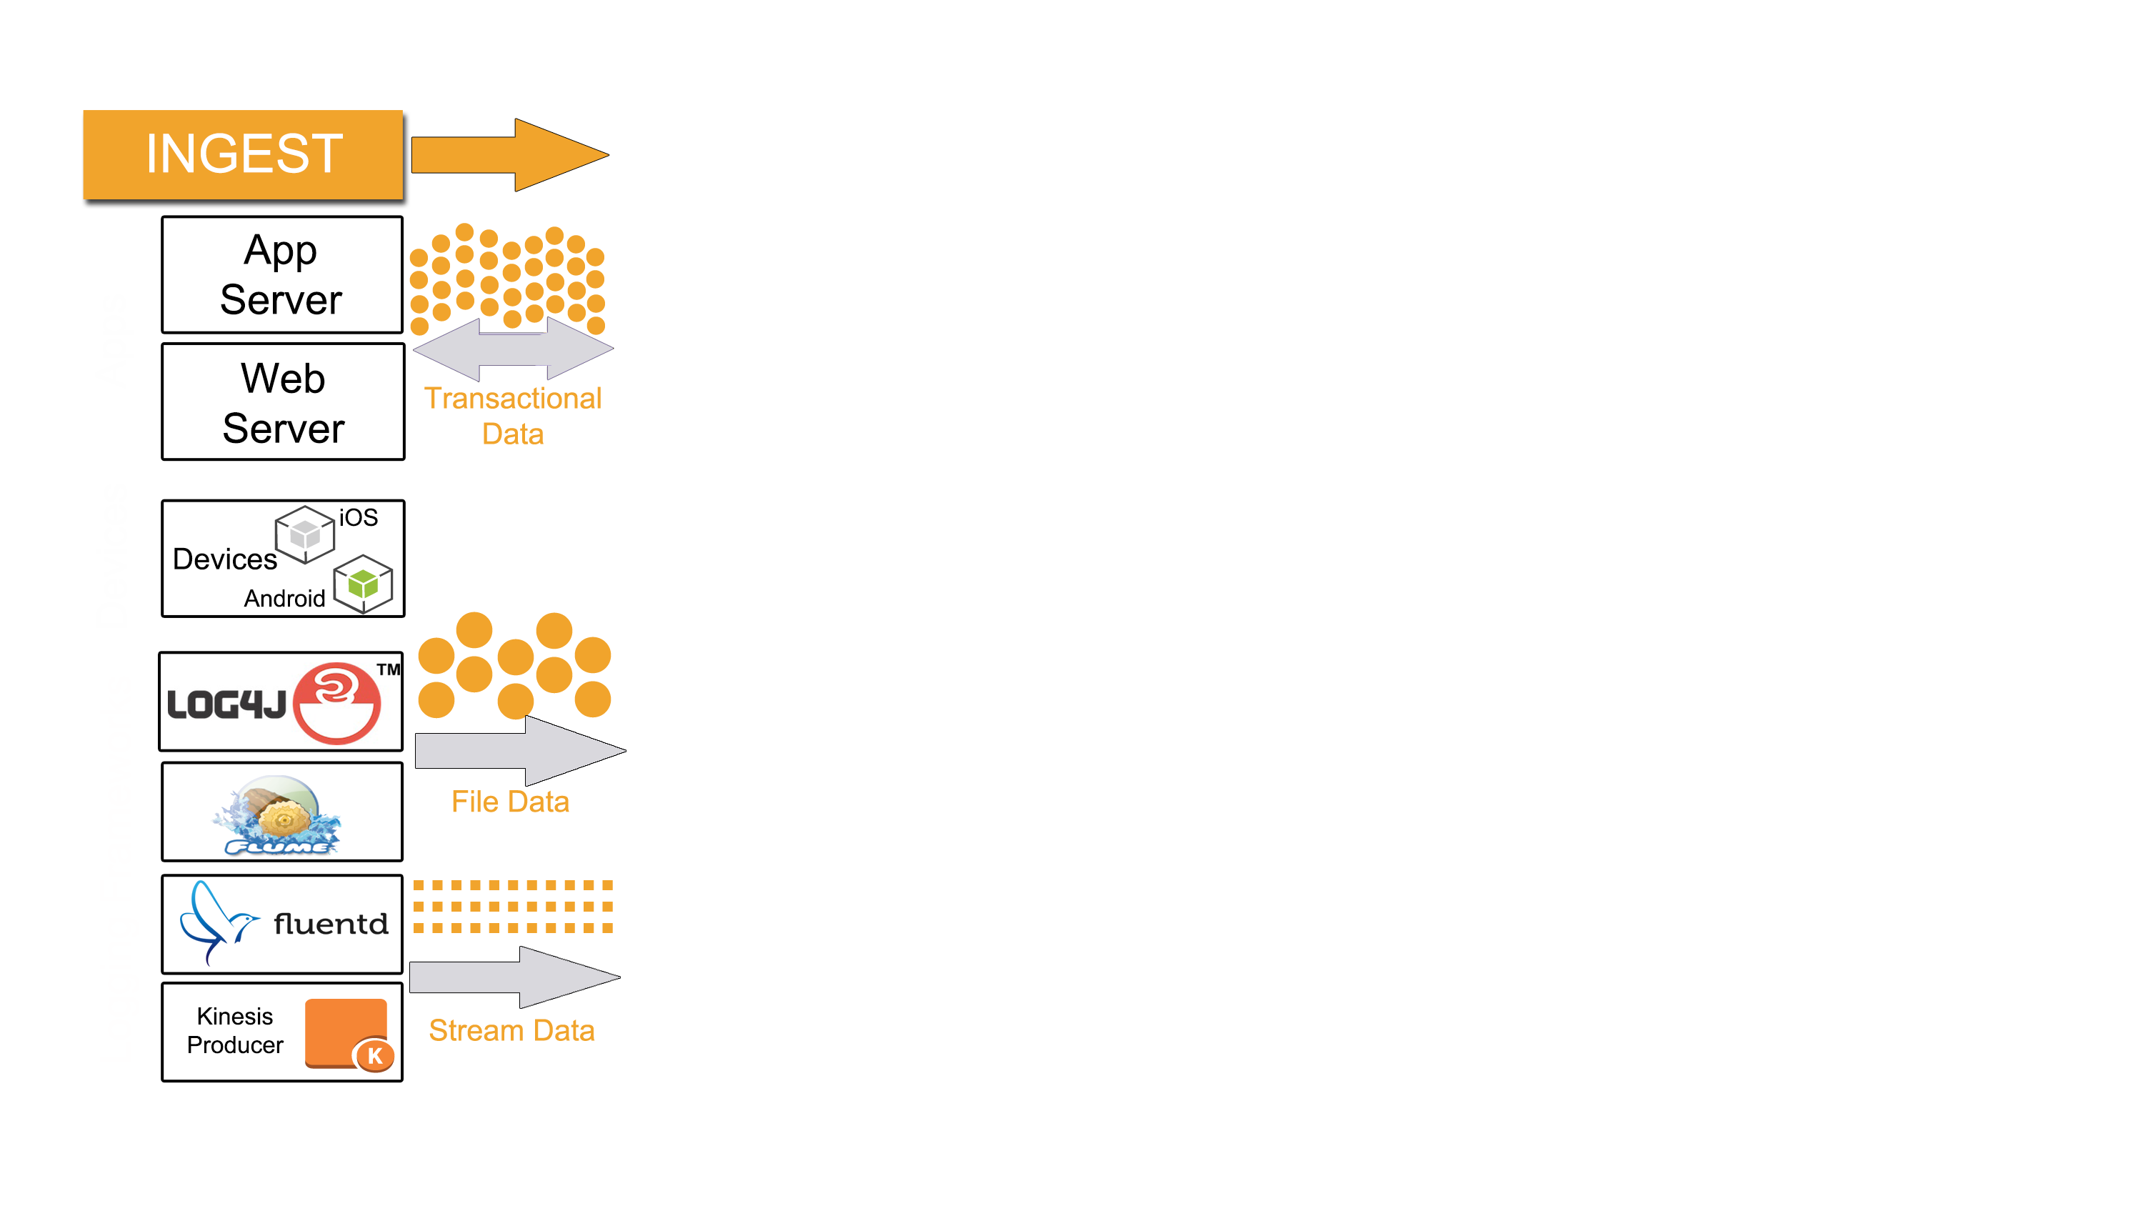

Types of Data Ingest
Transactional: Database reads/writes
App server
Database
Web server
Amazon RDS
DynamoDB
Devices
Mobile apps
Browsers
Cloud Storage
File
Game consoles
DVRs
Sensor/Geo data
IoT
Flume
Log4j
Amazon S3
Fluentd
Kinesis
Producer/Firehose
Stream
Storage
Stream
Sqoop
Storm
Amazon Kinesis
Notes:
Use the type of data your environment is collecting and the manner in which it is collected to determine what kind of ingestion solution is ideal for your needs.
Transactional data needs to be able to quickly store and retrieve small pieces of data. End-users need quick and straight-forward access to the data, making app and web servers the ideal ingestion methods. For the same reasons, databases, such as DynamoDB and Amazon RDS, are usually the best solution for these kinds of processes.
Data transmitted through individual files typically is ingested from connected devices. This kind of log data does not require fast storage and retrieval like transactional data does, and also transferal is one-way, so ingestion can come from a wide-variety of sources. This kind of data is typically stored in Amazon S3.
Stream data, such as click-stream logs, should be ingested through an appropriate solution such as a Kinesis-enabled application or fluentd. Initially, these logs are stored in stream storage solutions such as Kinesis, so they're available for real-time processing and analysis. Long-term storage of these logs would best be done in a low-cost solution such as Amazon S3.

Slide 38
Decoupling the "data bus": Flexibility
With a decoupled data bus, you can have multiple processing applications read from or write to multiple data stores:
Amazon Kinesis S3 Connector
Storage
Processing
Storage
Data
Amazon Kinesis
EMR
DynamoDB
Amazon S3

Slide 39
Decoupling the "data bus": Flexibility
With a decoupled data bus, you can have multiple processing applications read from or write to multiple data stores:
Amazon Kinesis S3 Connector
Storage
Processing
Storage
Data
Amazon Kinesis
EMR
Amazon RDS
Amazon S3

Slide 40

Decoupling the "data bus": Flexibility
Connecting an access layer can make it easier for your end-users to understand and gain insight from data coming from multiple sources:
Amazon Kinesis S3 Connector
Storage
Processing
Storage
Access
Data
Insight
EMR
Amazon S3
Amazon RDS
QuickSight
DynamoDB

Slide 41
Choosing a datastore: Data/access characteristics
 | Hot | Warm | Cold
Volume | MB-GB | GB-TB | PB
Item size | B-KB | KB-MB | KB-TB
Latency | ms | ms, sec | min, hrs
Durability | Low-high | High | Very high
Request rate | Very high | High | Low
Cost/GB | $$-$ | $-¢¢ | ¢

Slide 42
Datastore Comparison
 | DynamoDB | Amazon RDS | Amazon Redshift | Amazon EBS | Amazon S3 | Amazon Glacier
Average latency | ms | ms, sec | sec,min | ms | ms, sec, min (~ size) | hrs
Data volume | GB–TB (no limit) | GB–TB (Varies by database engine) | TB–PB (1.6 PB max) | GB–TB (16 TB Max) | GB–PB (no limit) | GB–PB (no limit)
Item size | KB (400 KB max) | KB (~rowsize) | KB (64 K max) | Block storage | KB–GB (5 TB max) | GB (40 TB max)
Request rate | Very High | High | Low | Very High | Low– Very High (no limit) | Very Low (no limit)
Cost/GB per month | ¢¢ | ¢¢ | ¢ | ¢¢ | ¢ | ¢
Durability | Very High | High | High | High | Very High | Very High
Hot
Cold

Slide 43


Choosing a data store: Cost considerations
300 writes/sec | 2,048 bytes object size | 1,483 GB/month | 777,600,000 objects/month
Scenario 1:
Scenario 2:
300 writes/sec | 32,768 bytes object size | 23,730 GB/month | 777,600,000 objects/month
OR
Amazon S3
DynamoDB
Notes:
Given two scenarios, both with the same request rate and number of objects stored per month, but with an enormous difference in object and total storage size, the same storage solution may not be best for both scenarios.

Slide 44
Choosing a data store: Cost considerations
300 writes/sec | 2,048 bytes object size | 1,483 GB/month | 777,600,000 objects/month
Scenario 1:
Throughput capacity: $261.69
Indexed data stored: $382.61
Total per month: $644.30
Storage: $44.27
Put/List Requests: $3,888.00
Total per month: $3,932.27
Amazon S3
DynamoDB
Notes:
In Scenario 1, with the smaller object size and total storage size per month, DynamoDB is the more cost-effective option for storing this data.

Slide 45
Choosing a data store: Cost considerations
300 writes/sec | 32,768 bytes object size | 23,730 GB/month | 777,600,000 objects/month
Scenario 2:
Indexed data stored: $5,944.36
Throughput capacity: $4,187.04
Total per month: $10,131.40
Storage: $700.55
Put/List Requests: $3,888.00
Total per month: $4,588.55
Amazon S3
DynamoDB
Notes:
In Scenario 2, with the much larger object size and storage size per month, Amazon S3 costs more than 50% less than the same data stored in DynamoDB.

Slide 46
S3: Data partitioning
Example:
Log processing:
Data processed once per hour
Data access pattern based on time
Partition based on day and hour
/data/logs/YYYY/MM/DD/HH/logfiles for this given hour
/data/logs/2016/01/01/02/logfile1 .../logfile2 .../logfile3
/data/logs/2016/01/01/03/logfile1
.../logfile2
.../logfile3

Slide 47




Where do AWS solutions map to the pipeline?
Ingest
Store
Analyze & Process
Visualization
Amazon S3
Amazon Glacier
EMR
Amazon Redshift
QuickSight
Web/app servers
Amazon Kinesis- enabled app
DynamoDB
Amazon RDS
Data Pipeline
Amazon Kinesis Connector
Amazon SQS
Amazon Kinesis
CloudSearch
Notes:
On AWS, ingestion can be accomplished using Amazon EC2 instances running Kinesis-enabled or other applications designed for ingestion. AWS Data Pipeline can also be used to ingest data from on-premises sources into AWS.
We have a wide variety of storage solutions; however, the most commonly used in big data environments running on AWS is Amazon S3. We'll go over these storage solutions later on in the course. It's also important to note that due to the nature of big data, storage will be used both before and after the analysis and processing phases, for storing results for viewing and for further analysis or processing.
The primary tool for big data processing in the AWS big data ecosystem is Amazon EMR, and we'll talk about that service in the next several modules. Amazon Redshift, our petabyte-scale data warehouse solution, will be detailed on day three of the course, and is the primary solution for finding more detailed answers from analyses of your data. We'll also go over Amazon Kinesis, our streaming data processing solution, and AWS Data Pipeline, our data transformation solution, in later modules.

Slide 48
Where do AWS solutions map to the pipeline?
Collect
Store
Process & Analyze
Visualize
Real-time
Amazon Kinesis Firehose
Data Import
Amazon Import/Export Snowball
Message Queuing
Amazon SQA
Web/app Servers
Amazon EC2
Object Storage
Amazon S3
Amazon Glacier
Real-time
Amazon Kinesis Streams
RDBMS
Amazon RDS
NoSQL
DynamoDB
Search
Amazon CloudSearch
IoT
Amazon IoT
Hadoop Ecosystem
Amazon EMR
Real-time
AWS Lambda
Amazon Kinesis Analytics
Data Warehousing
Amazon Redshift
Machine Learning
Amazon Machine Learning
Elastic Search Analytics
Amazon ElasticSearch
Process & Move Data
AWS Data Pipeline
Business Intelligence & Data Visualization
Amazon QuickSight
Elastic Search Analytics
Amazon ElasticSearch
Notes:
On AWS, collection and ingestion can be accomplished using Amazon EC2 instances running Kinesis-enabled or other applications designed for ingestion. AWS Data Pipeline can also be used to ingest data from on-premises sources into AWS.
We have a wide variety of storage solutions; however, the most commonly used in big data environments running on AWS is Amazon S3. We'll go over these storage solutions later on in the course. It's also important to note that due to the nature of big data, storage will be used both before and after the analysis and processing phases, for storing results for viewing and for further analysis or processing.
The primary tool for big data processing in the AWS big data ecosystem is Amazon EMR, and we'll talk about that service in the next several modules. Amazon Redshift, our petabyte-scale data warehouse solution, will be detailed on day three of the course, and is the primary solution for finding more detailed answers from analyses of your data. We'll also go over Amazon Kinesis, our streaming data processing solution, and AWS Data Pipeline, our data transformation solution, in later modules.
Some of these tools are often used in more than one of these categories.

Slide 49
What kinds of tools can I use with AWS?
Collect
Store
Process & Analyze
Visualize
Fluentd
Flume
Log4j
Sqoop
HDFS
Cassandra
Kafka
HBase
Hadoop
Spark
Hive
Oozie
Mahout
Presto
Pig
Impala
SAS
Qlik
Looker
Flot
Tableau
Tibco Spotfire
Tibco Jaspersoft
…and more
Notes:
As displayed above, AWS's big data solutions are compatible with an enormous collection of non-AWS tools at every stage of the pipeline. These are just a small collection of the tools available to be used within the AWS big data ecosystem.

Slide 50
What is EMR?

Slide 51

Amazon EMR
Amazon EMR is a managed cluster platform that you can use to:
Run Hadoop, Spark, Presto and other applications
Launch a cluster in minutes
Deploy multiple clusters
Resize a running cluster
Cost-effectively process vast amounts of data
Use HDFS and S3 file systems
Amazon EMR
Notes:
Amazon Elastic MapReduce (Amazon EMR) is a managed cluster platform that simplifies running big data frameworks, such as Apache Hadoop and Apache Spark, on AWS to process and analyze vast amounts of data. By using these frameworks and related open-source projects, such as Apache Hive and Apache Pig, you can process data for analytics purposes and business intelligence workloads. Additionally, you can use Amazon EMR to transform and move large amounts of data into and out of other AWS data stores and databases, such as Amazon Simple Storage Service (Amazon S3) and Amazon DynamoDB.

Slide 52

Apache Hadoop
Open source project managed by Apache Software Foundation
Distributed processing of massive amounts of data across clusters of “commodity” hardware
Provides reliability and performance through data replication
Map/Reduce in paralell-distributed processes
Notes:
Hadoop uses a distributed processing architecture, in which a task is mapped to a cluster of commodity servers for processing. Each piece of work distributed to the cluster servers may be run or re-run on any of the servers. The cluster servers frequently use HDFS (Hadoop Distributed File System) to store data locally for processing. The results of the computation performed by those servers are then reduced down to a single output set. One node, designated as the master node, controls the distribution of tasks and can automatically handle server failures.

Slide 53
What is MapReduce?
MapReduce is a framework for processing large data sets with a parallel, distributed algorithm on a cluster.
Map(): distribute and filter
Reduce(): collate and summarize
Notes:
Take a big job, split it up into discrete tasks and do them in parallel. It is the framework at the core of Hadoop, and it allows for massive scalability across enormous numbers of Hadoop clusters. It's also designed for fault-tolerance, where each of the worker nodes periodically report their statuses to a master node, and the master node is able to redistribute work from a cluster that doesn't respond positively.

Slide 54
MapReduce Process
Input file
map
reduce
Output file
Input file
map
reduce
Output file
Input file
map
reduce
Output file
Notes:
The input file is split as defined by the InputFormat. The portions of input data are mapped to key/value pairs (local intermediate data) during the mapping phase, where they are analyzed in parallel across the Hadoop cluster. Once mapped, the data is copied to the reducers in the shuffle/sort phase. The data is then reduced and the output file is created.
Note: in this scenario, this job is only counting the green, orange, and red data, which is why you don't see reducers for the blue data. The next slide will show this in more detail.

Slide 55
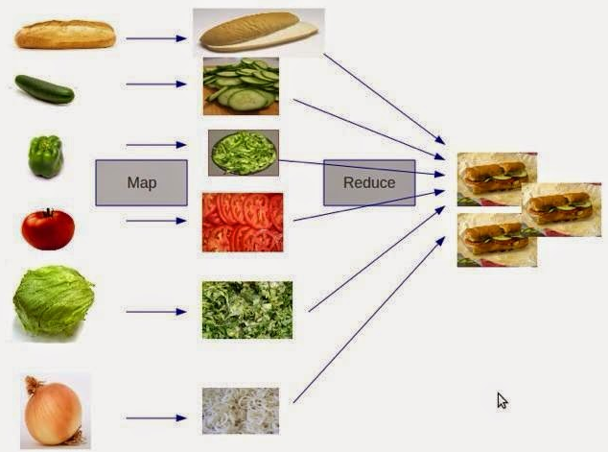
MapReduce Process
Notes:
From http://www.hadoop360.com/blog/50-articles-about-hadoop-and-related-topics/

Slide 56


Typical Amazon EMR Environment – Hadoop 1 and 2
Master instance controls the cluster
Master instance group
Core instances:
Manage data and tasks
Can be added and removed
Task instances (optional) are added or subtracted in response to work
HDFS
HDFS
Core instance group
Task instance group
Amazon S3 can function as underlying file system (EMRFS)
Amazon S3
Notes:
An Amazon EMR cluster consists of 3 types of nodes: a master node, a series of core nodes, and a series of task nodes (optional). The master node manages the cluster: coordinating the distribution of the MapReduce executable and subsets of the raw data, to the core and task instance groups. It also tracks the status of each task performed, and monitors the health of the instance groups. There is only one master node in a cluster; this maps to the Hadoop master node. Core nodes run tasks and store data using the Hadoop Distributed File System (HDFS). Core nodes map to Hadoop slave nodes. Task nodes (optional) run tasks (they do not use HDFS for storage). Task nodes map to Hadoop slave nodes.
These nodes are deployed using Amazon EC2 instances. Each of the node types is discussed on the following pages.
Note: Scaling core instance groups in is typically not recommended, since intermittent/HDFS data stored on terminated core instances will be lost permanently and completed or in-progress work can be easily lost. You can leverage the "graceful shrinking" feature for scaling worker instance groups in, however:
http://docs.aws.amazon.com/ElasticMapReduce/latest/ManagementGuide/emr-manage-resize.html#graceful-shrink

Slide 57

Amazon EC2 is the base of EMR
Agility
Flexibility
Manageability
Notes:
Amazon EC2 enables you to increase or decrease capacity within minutes, not hours or days. You can commission one, hundreds or even thousands of server instances simultaneously. Of course, because this is all controlled with web service APIs, your application can automatically scale itself up and down depending on its needs. Our data center footprint is global, spanning 5 continents with highly redundant clusters of data centers in each region. Our footprint is expanding continuously as we increase capacity, redundancy and add locations to meet the needs of our customers around the world.

Slide 58
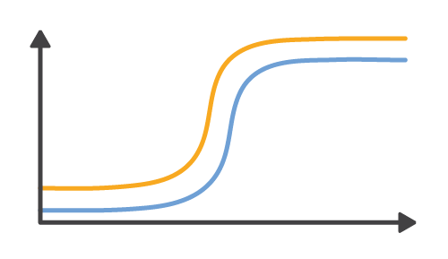
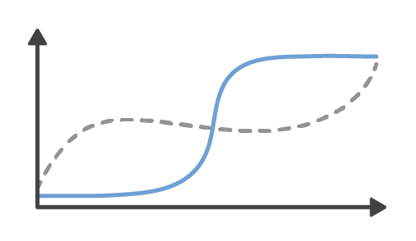
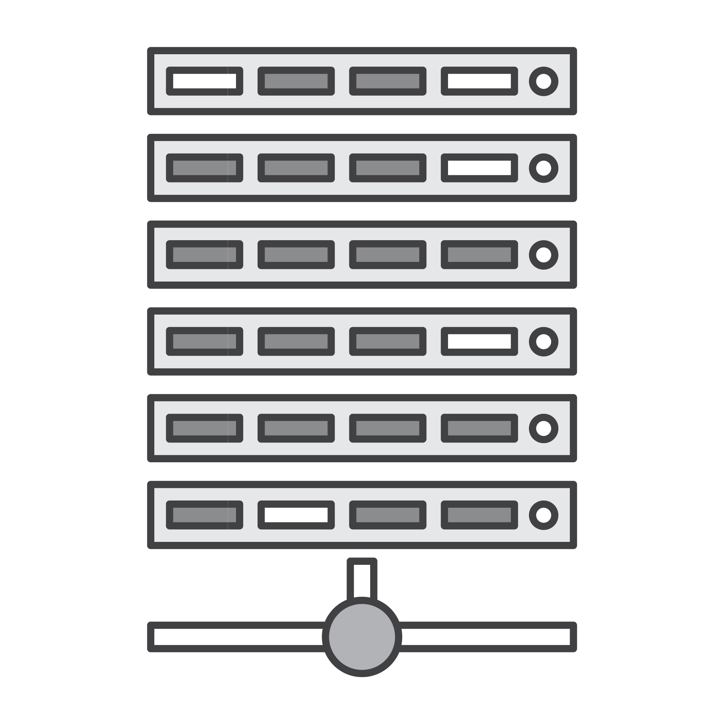


Benefits of Agility
Resources scaled to demand
Actual Demand
Predicted Demand
Actual demand
Waste
Customer Dissatisfaction
Rigid On-Premises Resources
Elastic Cloud-Based Resources

Slide 59

Big Job

Slide 60

Cluster
Big Job

Slide 61

Big Job
Cluster

Slide 62

AWS instance clusters can be balanced to the job in hand…
Cluster
Big Job

Slide 63


…with multiple clusters running at the same time

Slide 64
What is Redshift?

Slide 65
Amazon Redshift architecture
Leader Node
SQL endpoint
Stores metadata
Coordinates query execution
Compute Nodes
Local, columnar storage
Execute queries in parallel
Load, backup, restore via Amazon S3; load from Amazon DynamoDB or SSH
Two hardware platforms
Optimized for data processing
dc1: SSD; scale from 160GB to 326TB
ds2: HDD; scale from 2TB to 2PB
SQL Clients/BI Tools
JDBC/ODBC
Data Warehouse Cluster
RAM
Leader Node
cores
disk
RAM
RAM
RAM
Compute Nodes
cores
cores
cores
disk
disk
disk
Ingestion
Backup
Restore
Amazon S3 / DynamoDB / SSH
Notes:
More information on loading into Amazon Redshift through SSH:
https://docs.aws.amazon.com/redshift/latest/dg/loading-data-from-remote-hosts.html

Slide 66
Sizing and resizing your cluster
SQL Clients/BI Tools
Leader Node
Leader Node
128GB RAM
128GB RAM
16 cores
16 cores
48TB disk
48TB disk
Compute Node
Compute Node
Compute Node
Compute Node
Compute Node
Compute Node
Compute Node
128GB RAM
128GB RAM
128GB RAM
128GB RAM
128GB RAM
128GB RAM
128GB RAM
16 cores
16 cores
16 cores
16 cores
16 cores
16 cores
16 cores
48TB disk
48TB disk
48TB disk
48TB disk
48TB disk
48TB disk
48TB disk
Start small and grow with your data
Automatic SQL endpoint switchover via DNS
Simple operation via console or API
Notes:
During switchover to a change in cluster size, cluster will change to read-only.

Slide 67
Distribution style: EVEN
1
ID | Gender | Name
ID | Gender | Name
101 | M | John Smith
ID | Gender | Name
306 | F | Lisa Green
ID | Gender | Name
101 | M | John Smith
292 | F | Jane Jones
139 | M | Peter Black
446 | M | Pat Partridge
658 | F | Sarah Cyan
164 | M | Brian Snail
209 | M | James White
306 | F | Lisa Green
2
ID | Gender | Name
ID | Gender | Name
292 | F | Jane Jones
ID | Gender | Name
209 | M | James White
Round robin
ID | Gender | Name
139 | M | Peter Black
3
ID | Gender | Name
ID | Gender | Name
164 | M | Brian Snail
ID | Gender | Name
4
ID | Gender | Name
446 | M | Pat Partridge
ID | Gender | Name
658 | F | Sarah Cyan

Slide 68
Distribution style: KEY
ID | Gender | Name
101 | M | John Smith
ID | Gender | Name
139 | M | Peter Black
ID | Gender | Name
446 | M | Pat Partridge
ID | Gender | Name
164 | M | Brian Snail
ID | Gender | Name
209 | M | James White
ID | Gender | Name
1
ID | Gender | Name
101 | M | John Smith
292 | F | Jane Jones
139 | M | Peter Black
446 | M | Pat Partridge
658 | F | Sarah Cyan
164 | M | Brian Snail
209 | M | James White
306 | F | Lisa Green
Hash Function
ID | Gender | Name
292 | F | Jane Jones
ID | Gender | Name
658 | F | Sarah Cyan
ID | Gender | Name
ID | Gender | Name
306 | F | Lisa Green
2

Slide 69
Distribution style: ALL
101 | M | John Smith
292 | F | Jane Jones
139 | M | Peter Black
446 | M | Pat Partridge
658 | F | Sarah Cyan
164 | M | Brian Snail
209 | M | James White
306 | F | Lisa Green
1
ID | Gender | Name
101 | M | John Smith
292 | F | Jane Jones
139 | M | Peter Black
446 | M | Pat Partridge
658 | F | Sarah Cyan
164 | M | Brian Snail
209 | M | James White
306 | F | Lisa Green
101 | M | John Smith
292 | F | Jane Jones
139 | M | Peter Black
446 | M | Pat Partridge
658 | F | Sarah Cyan
164 | M | Brian Snail
209 | M | James White
306 | F | Lisa Green
2
Duplication
101 | M | John Smith
292 | F | Jane Jones
139 | M | Peter Black
446 | M | Pat Partridge
658 | F | Sarah Cyan
164 | M | Brian Snail
209 | M | James White
306 | F | Lisa Green
3
101 | M | John Smith
292 | F | Jane Jones
139 | M | Peter Black
446 | M | Pat Partridge
658 | F | Sarah Cyan
164 | M | Brian Snail
209 | M | James White
306 | F | Lisa Green
4

Slide 70
Row-wise storage complicates analytics
However, if you tried to find the total of all sales using row-wise storage, it has to search every record:
ID | Age | State | Amount
123 | 20 | CA | 500
345 | 25 | WA | 250
567 | 31 | NY | 100
789 | 58 | TX | 230
123 | 20 | CA | 500
500
345 | 25 | WA | 250
+ 250
567 | 31 | NY | 100
+ 100
789 | 58 | TX | 230
+ 230
1080
Notes:
Row-wise storage is the traditional method for RDBMSs, because most operations performed on typical relational databases are queries, which perform best when single values are being requested. If you were to run a basic analytic operation on this kind of storage, such as requesting the total amount spent, the operation would have to go through every block individually and retrieve the fourth value in each before being able to perform a SUM operation. This adds an extensive amount of I/O to what is ultimately a simple operation.

Slide 71
Columnar storage is best for analytic workloads
To find out how much all customers spent, the operation simply finds the block where the Amount records are stored and pulls out all values stored there:
ID | Age | State | Amount
123 | 20 | CA | 500
345 | 49 | WA | 250
567 | 31 | NY | 100
789 | 58 | TX | 230
123 | 345 | 567 | 789
20 | 49 | 31 | 58
CA | WA | NY | TX
500 | 100 | 250 | 230
= 1080
Notes:
Therefore, columnar storage is best for analytic workloads. In the above example, finding out the total amount spent requires locating only one block, retrieving all of the values stored there, and then performing the SUM operation. In the previous slide, the same request would have required four separate blocks to be accessed, whereas here only one has to be accessed. Likewise, with this columnar storage format, performing a simple query on how much customer 567 spent would introduce significantly more I/O than with row-wise storage.

Slide 72
Hands-on: Labs!
https://aws.qwiklabs.com/
http://bit.ly/infnet-bigdata-workshop

Slide 73

Apache Hive
Facilitates querying and managing large datasets residing in distributed storage (S3, DynamoDB, RDS, HBase, etc.)
Simple, cost-effective data warehouse-style solution
Query language (HiveQL) enables SQL-like queries
Hive leverages MapReduce for queries.
Notes:
Hive is an open-source analytic package that runs on top of Hadoop and offers some limited data warehouse capabilities, such as being able to transform source data into data warehouse-style fact and dimension table-based star schemas. Hive scripts use a SQL-like language called HiveQL (query language) that abstracts the MapReduce programming model and supports typical data warehouse interactions. Hive enables you to avoid the complexities of writing MapReduce programs in a lower level computer language, such as Java.
Hive extends the SQL paradigm by including serialization formats and the ability to invoke mapper and reducer scripts. In contrast to SQL, which only supports primitive value types (such as dates, numbers, and strings), values in Hive tables are structured elements, such as JSON objects, any user-defined data type, or any function written in Java. For more information on Hive, go to http://hive.apache.org/
Amazon Elastic MapReduce (Amazon EMR) provides support for Apache Hive. Amazon EMR supports several versions of Hive, which you can install on any running cluster. Amazon EMR also allows you to run multiple versions concurrently, allowing you to control your Hive version upgrade.
In addition to MapReduce, Hive also supports running queries on Apache Tez. Tez is an extensible and embeddable framework that works within YARN on Hadoop to improve speed and bridge the gap between interactive and batch workloads. More here: https://tez.apache.org/

Slide 74
Lab 1
Storing and Querying Data on DynamoDB
Notes:
Approximate timing: ~30 minutes

Slide 75
Lab 1: Storing and Querying Data on DynamoDB
Scenario:
An internet retail company logs its sales in simple tables stored in an Amazon S3 bucket. The logs are partitioned by year and month.
The company wants to know who its biggest customer during the first week of 2012 was, as well as that customer's total purchase amount over the prior six months.
To do this, you will create tables in DynamoDB out of the data from Amazon S3, and then query the data.
All of these commands will be done through Hive (a data processing framework) running on an Amazon EMR cluster (a group of cloud compute instances).
We will talk about Hive and Amazon EMR in later modules.

Slide 76


Lab 1: Storing and Querying Data on DynamoDB
DynamoDB
SSH
You
Amazon EMR (with Hive)
Amazon S3
Basic architecture and flow
Notes:
In this lab, you will SSH into an already running Amazon EMR cluster running Hive. Using Hive, you will create tables in DynamoDB, load data into those tables from Amazon S3, run queries against the data in those DynamoDB tables, and then export some of the data back into Amazon S3.

Slide 77
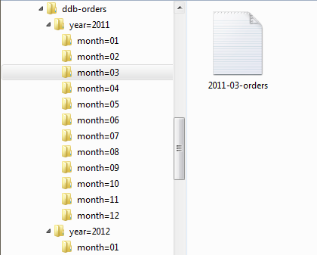
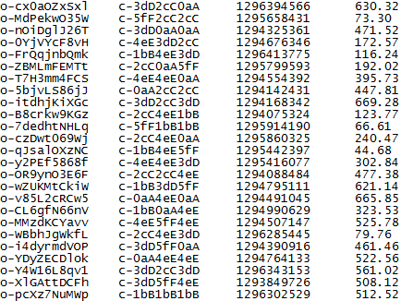
Lab 1: Input data
Order_ID
Customer_ID
Order_date
Total
Stored logs structure (in Amazon S3)
Raw log data (sample)

Slide 78


Lab 1: Storing and Querying Data on DynamoDB
Amazon EMR
INSERT
Amazon S3
Historical data (orders_s3_export)
January 2012 data
(orders_ddb_2012_01)
DynamoDB
INSERT
Results (orders_s3_new_export)
Notes:
You start with an Amazon S3 bucket that has been pre-populated with sales log files. These files have been partitioned, first by year of the record, then by month.
Create a DynamoDB table called "Orders-2012-01"
Create an S3 bucket
Create a Hive external table named "orders_s3_export" that points to data already in S3
Create a Hive external table named "orders_ddb_2012_01" that stores data in the DynamoDB table called "Orders-2012-01" (created in 1.1)
Copy data from "orders_s3_export" (S3) to "orders_ddb_2012_01" (DynamoDB)
Create a Hive external table named "orders_s3_new_export" that stores data in the student's S3 bucket
Copy data from "orders_ddb_2012_01" (DynamoDB) to "orders_s3_new_export" (S3)
(In a real-world scenario, you would then delete your historical data table in order to save money on storage)

Slide 79
Lab 1: Storing and Querying Data on DynamoDB
Create a DynamoDB table
Create tables from your Amazon S3 input data using an interactive Hive session
Write data to a DynamoDB table
Query DynamoDB data
Export data to Amazon S3 and query it

Slide 80
Lab 6
Using Amazon Redshift for Big Data
© 2016 Amazon Web Services, Inc. and its affiliates. All rights reserved.
Notes:
Approximate timing: ~1.5 hours

Slide 81








Acme's Environment
Internet
Data Sources
Amazon CloudFront logs
Orders database
User profile table
Internet gateway
CloudFront
Web server/caching
Web server/caching
Games, modules and images for download
Order Processing System
Catalog
Profile
Purchasing
Catalog
Profile
Purchasing
Orders DB
Services
Services
User profile table
Acme Data Center
Catalog DB
Data
Data
DynamoDB

Slide 82

Loading logs and related data
Uses data from ETL processing
User, order and game data pre-extracted from production systems
All data staged to Amazon S3
Log files (ETL output)
User data
Order data
Game data
Amazon Redshift

Slide 83
Lab 7
Using Tibco Spotfire to Visualize Data
© 2016 Amazon Web Services, Inc. and its affiliates. All rights reserved.
Notes:
Approximate timing: ~30 minutes

Slide 84
Lab 7: Using Tibco Spotfire to Visualize Data
Scenario:
Business users at the Acme game company (from the last lab) would like to learn more about the traffic for their game as well as some demographic information about the people who play it
Using the tables created in Amazon Redshift in the last lab, you will create a dashboard in Tibco Spotfire that will display this data in three charts:
Unique Daily Visitors (line chart)
Unique Visitors by Country (pie chart)
Total Visitors by Age and Gender (bar chart)

Slide 85
Hands-on: Labs!
https://aws.qwiklabs.com/
http://bit.ly/infnet-bigdata-workshop

Slide 86
Key points
Pipelines: you will have plenty!
Permanent data: lives on S3, RDS, Dynamo, Redshift.
EC2/EMR: temporary compute power.
On-demand: provision when needed. Terminate when finished.

Slide 87
Questions?

Slide 88

Next Steps
AWS Free Tier
Documentation
Whitepapers
www.qwiklab.com
Reference Architecture
AWS Marketplace
Explore our training options

Slide 89

Thank you!
Mv – mvferr@amazon.com

